Slide 1




Danskammer Legal Update
Hayley Carlock, Esq., Scenic Hudson

Slide 2
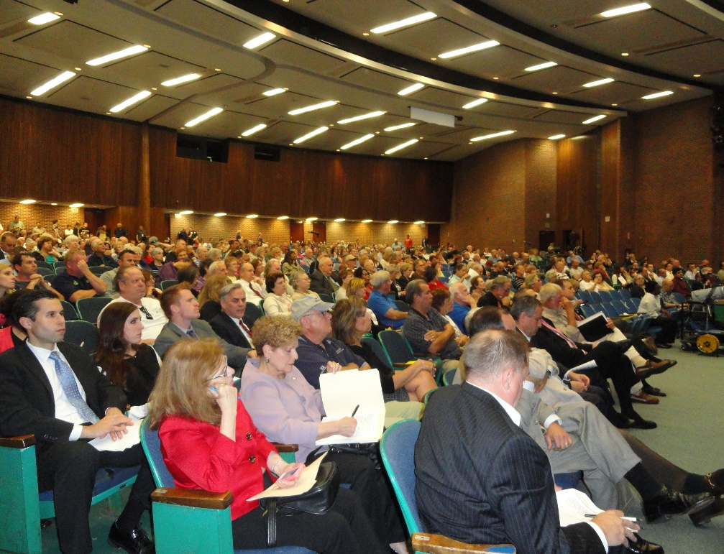
NYS Public Service Law Article 10:
One-Stop Shopping for Power Plants
Any electricity-generating plant over 25 megawatts
All state and local permits and approvals reviewed through Article 10
Local laws can be overridden if they are “unreasonably burdensome”
Involves in-depth review of economic, energy system, public health and environmental impacts and consistency with NYS Energy Policy

Slide 3
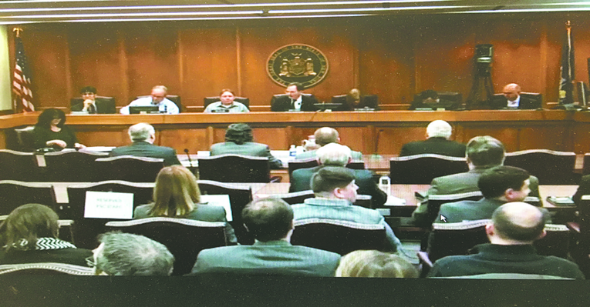
Who Makes the Decision: NYS Board on Electric Generation Siting and the Environment
The Siting Board consists of five permanent members (heads of five state agencies: PSC, NYSERDA, DEC, DOH and ESD) and two public members drawn from the community
Governor has strong influence over decisions

Slide 4

Decision must be made within 12 months of application acceptance
We are here
Notes:
Five permanent members (heads of five state agencies) and two ad-hoc members drawn from the local community
Parties (“intervenors”) can file documents on the administrative record of the proceeding, be eligible for intervenor funding and participate in stipulations and the trial-type evidentiary hearing
Non-party stakeholders may submit comments and participate in public statement hearings

Slide 5

Where are We Now, and What’s Next?
Danskammer’s application deemed “complete” and ready for review, kicking off the Article 10 permitting process
Legal proceeding begins 4/1
Important opportunities for members of the public to voice opposition to the decision-makers:
  March 31 Public Statement Hearings, 1pm or 6pm. MUST REGISTER BY 3/29
  Written comments accepted throughout proceeding: on.ny.gov/32lBiiR or email to secretary@dps.ny.gov (Case 13-F-0325)

